Slide 1
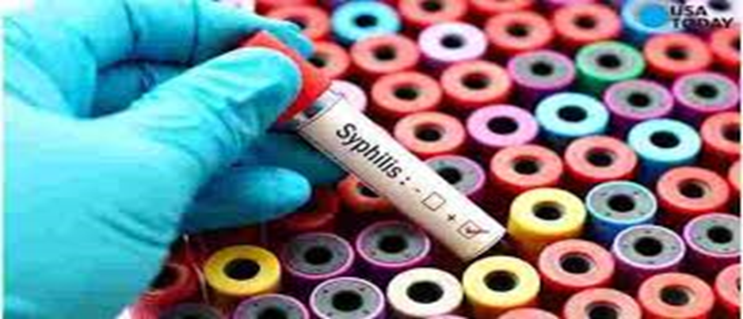
Syphilis on the rise
Name
Institution of Affiliation

Slide 2
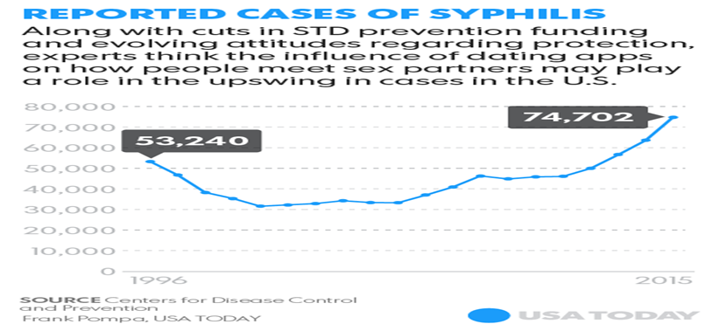
Syphilis
The infectious condition is on the rise because of many factors
Sexual relations is a critical factor contributing to the increased cases
In the modern society most relations are founded through social media
People have no time to meet and get to know their partners even before they engage into sexual activities.

Slide 3
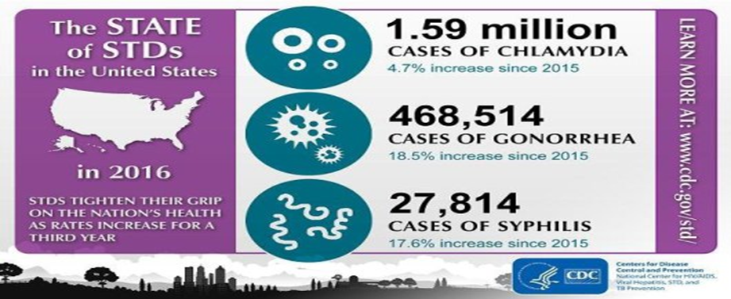
cont
Such relations causes an increase syphilis infections since when transmitted, it is difficult to trace the partner for treatment.
It is routine to find social media relationships not lasting.
This means that one person may infect more than one partner without knowing.
Furthermore, the condition is quite asymptomatic and one may not suspect the other person.

Slide 4
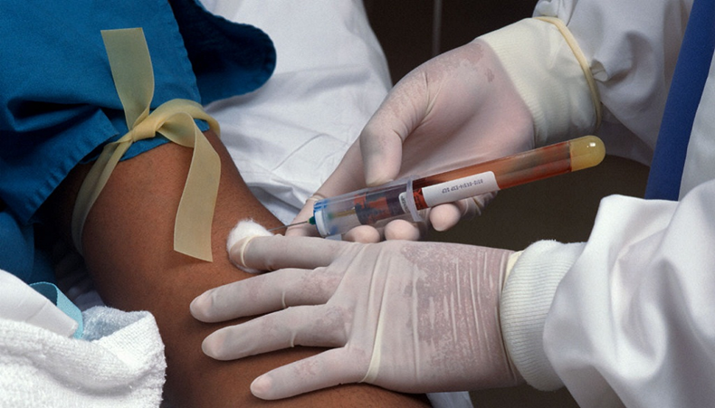
cont
The rise of the gay relationships has also led to an increase in the number of cases of syphilis.
It is not that attention has not been given in the condition by the healthcare providers but the patterns have changed.
Also, socialization through the social media and internet has contributed to the increased cases of syphilis.
Mass education is what is needed to reduce the increase.

